Slide 1
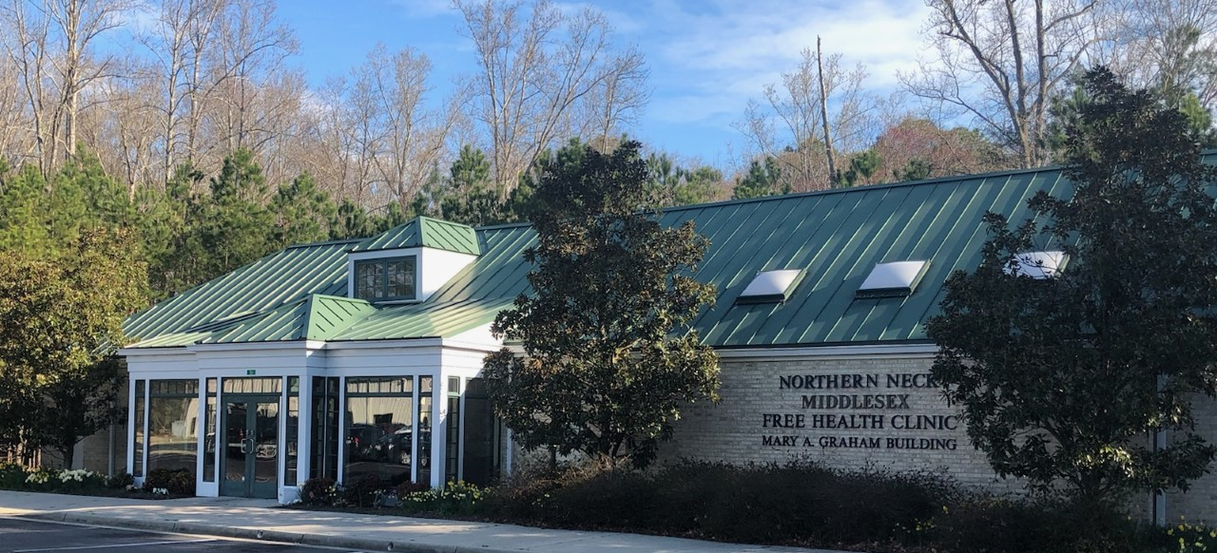
Northern Neck – Middlesex
FREE HEALTH CLINIC
Bridging
gaps in health care
since 1993
Medical Clinic w Dental Clinic w Pharmacy w Vaccine Clinics w Specialty Clinics w Referrals w Outreach
The health-care home for low-income, under-insured residents
in the Northern Neck and Middlesex County
P.O. Box 1694, 51 William B. Graham Court, Kilmarnock, VA, 22482
Phone: 435-0575 / Fax: 435-9017 / www.nnmfhc.org

Slide 2
NORTHERN NECK - MIDDLESEX FREE HEALTH CLINIC
Serving 5 counties:
Lancaster County
Middlesex County
Northumberland County
Richmond County
Westmoreland County
In 3 locations:
Main facility in Kilmarnock
Outreach Office in Middlesex County
Auxiliary Office in Kilmarnock

Slide 3
Our mission: We embrace health and wellness as the foundation for quality of life, and we dedicate ourselves to providing the highest level of health care to all those who ordinarily lack access to it within our community.
NORTHERN NECK - MIDDLESEX FREE HEALTH CLINIC

Slide 4
NORTHERN NECK - MIDDLESEX FREE HEALTH CLINIC
Patient population
Medical Clinic
Pharmacy
Dental Clinic
1,883 unduplicated patients served last year
Since 1993, the Clinic has served 18,100 individuals

Slide 5
Through 2022:
$137 million
in health care provided
2020-21:
With pandemic, outdoor
Vaccine Clinics added,
open to everyone
2004: Dental Clinic opens
2003: Clinic moves into Mary A. Graham building
2002: Outreach Clinic opens in Montross
1992-93: Founding members included
Richard Baylor, MD
Rocky Tingle, MD
Steve Glessner, MD
Bill Jewell
1993:
First (and only) Executive
Director, Jean Nelson, hired.
Clinic opens October 7.
1994:
First annual budget: $75,000
1995:
Phyllis Smith gives money for first Clinic home on DMV Drive
1996:
Ribbon-cutting held for new facility
1997:
Clinic expands to 5 days and 2 nights a week, including Women’s and Pediatric Clinics.

Slide 6
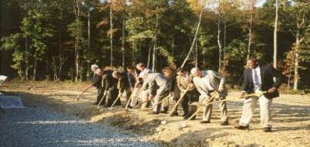
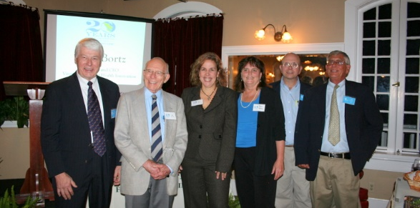
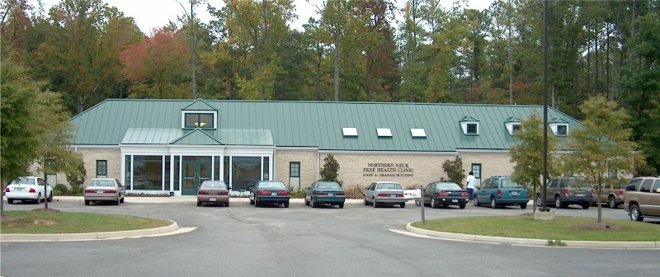
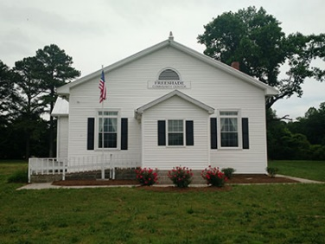
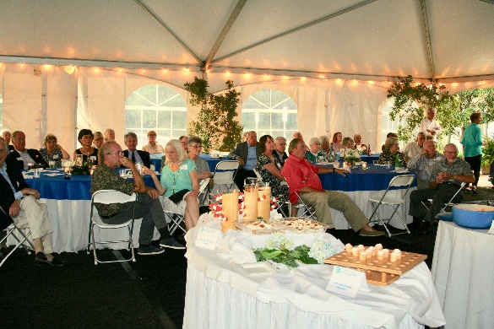
1998:
General Colin Powell speaks at groundbreaking for Virginia Quality Life Campus, which includes the NNMFHC
2001:
Final plans are unveiled for new facility, and VCU School of Dentistry partnership is established
2002:
Outreach Clinic in Montross opens at the Andrew Chapel United Methodist Church
2003:
The new facility opens
2004:
Dental Clinic opens
2011: The Diabetic Clinic is organized, and held weekly
2012:
10th anniversary of Outreach Clinic in Montross
2013:
20th anniversary observed
2017:
$101 million in care provided
14,500 individuals served
2018-19: 25th Anniversary celebrated.
Capital campaigns begin for electronic medical records and for building renovations. Campaigns completed in 2019-20.
2021-22: 17,500 individuals served; Covid Vaccine Clinics added; air filtration units installed
Groundbreaking
and
new facility
2005:
Pharmacy Tech class is developed
2006:
Foundation Board is formed
2007:
Clinic Pharmacy staff receive the Virginia Health Care Foundation’s “Unsung Hero Teamwork Award”
2008:
A special on the Clinic airs on local PBS station; Dr. Richard Baylor receives Medical Society of Virginia Foundation’s “Salute to Service” award
Phyllis Smith was the first major Clinic donor
2009:
Dr. Baylor wins national award from AMA for his volunteerism; Outreach Office opens in Hartfield
2010:
Clinic is fully accredited by the Virginia Association of Free Health Clinics; Mental health counseling is added through a partnership with the Community Service Board
Jean Nelson has been CEO since the Clinic’s founding

Slide 7
NORTHERN NECK - MIDDLESEX FREE HEALTH CLINIC
Patient population
By race / ethnicity
Black 776 41.2%
Hispanic 62 3.3%
White 1,002 53.2%
Other 43 2.3%

Slide 8
NORTHERN NECK - MIDDLESEX FREE HEALTH CLINIC
Patient population

Slide 9
Eligibility requirements by department
NORTHERN NECK - MIDDLESEX FREE HEALTH CLINIC
Medical Clinic
Uninsured and underinsured residents of Lancaster, Middlesex, Northumberland, Richmond and Westmoreland counties.
Qualified patients have incomes of 250% or less of the federal poverty level.
Patients may have Medicaid or Medicare but not private health insurance.
Financial documentation is needed to determine eligibility.
Pharmacy
Eligibility screening is required for all pharmacy medication programs on a yearly basis.
The Pharmacy serves the Clinic’s medical and dental uninsured and under-insured patients.
A $3 donation per prescription is requested at the time of pick up.
Dental Clinic
All Medical Clinic patients whose financial documentation is up to date are eligible.
Qualified patients have Incomes of 300% or less of the federal poverty level.
Medicaid and low-income Medicare patients with proper documentation are eligible.
Patients may come from adjacent counties as well as the primary service area.
A sliding fee scale of $30, $45, or $60 based on income is charged and must be made in advance of appointment.
Services are free for children.
The Clinic fills the GAP in health care.

Slide 10
NORTHERN NECK - MIDDLESEX FREE HEALTH CLINIC
“Low-income person" means an individual whose family's annual household income is not in excess
of 300% of the current poverty guidelines.” - Code of Virginia
Medical Clinic
Dental Clinic
Open to those with incomes at or below 250% of the federal poverty level (FPL). This threshold is established by the Board in keeping with support services provided by NNMFHC partners, including hospitals and pharmaceutical companies.
Income limits for medical services are:
Open to those with incomes at or below 300% of the federal poverty level (FPL). The Board approved this higher threshold due to the high cost of dental care, the limited access to dental services, and the general lack of affordable dental coverage in health-care insurance plans.
Income limits for dental services are:
Family | 250% of FPL
1 | $36,450 | $3,038
2 | $49,300 | $4,108
3 | $62,150 | $5,179
4 | $75,000 | $6,250
5 | $87,850 | $7,321
6 | $100,700 | $8,392
7 | $113,550 | $9,463
8 | $126,400 | $10,533
Additional | $12,850 | $1,070
Family | 300% of FPL
Size | Year | Month
1 | $43,740 | $3,645
2 | $59,160 | $4,930
3 | $74,580 | $6,215
4 | $90,000 | $7,500
5 | $105,420 | $8,785
6 | $120,840 | $10,070
7 | $136,260 | $11,355
8 | $151,680 | $12,640
Additional | $15,420 | $1,285

Slide 11
NORTHERN NECK - MIDDLESEX FREE HEALTH CLINIC
Services
Medical Clinic
Chronic and acute care
Specialty referrals
Laboratory tests
X-rays/CT scans
Nebulizer treatments
Flu and pneumonia vaccines
Covid-19 vaccines
School and sports physicals
Patient education
Mammograms
Dental Clinic
Dental services 5 days/week
Pharmacy Services
Prescriptions
Consultations and education
Specialty Clinics
Well-woman Clinics
Nephrology Clinics
Urology Clinics
Physical Therapy
Outreach Office in Syringa, Middlesex County

Slide 12
NORTHERN NECK - MIDDLESEX FREE HEALTH CLINIC
1,883 individuals served during 2022
VAFCC * = Services provided to patients in neighboring counties
at the request of member clinics of the Virginia Association of Free and Charitable Clinics

Slide 13
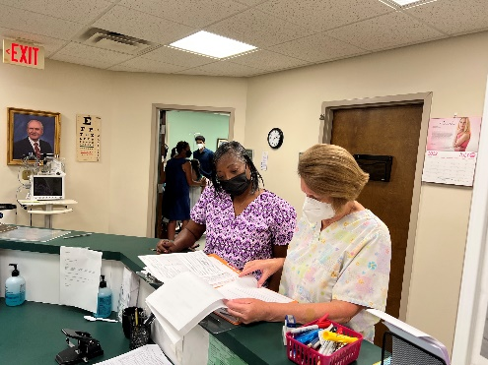
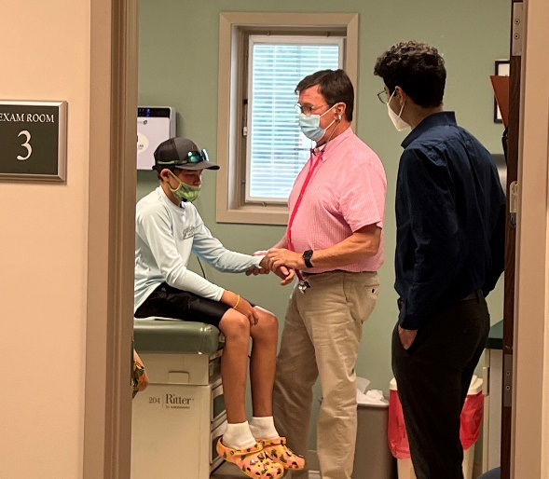
NORTHERN NECK - MIDDLESEX FREE HEALTH CLINIC
In the Medical Clinic
During 2022, the Medical Clinic:
Served 819 individuals
Hosted 4,084 visits
Provided referrals, CT scans, x-rays, mammograms, and labs
Back-to-school physicals:
Michele Fulcher and Sandi Sutherland (above) and Dr. Greg Lockhart (right)
Medical Clinic staff providers include Nurse Practitioner Tamara Hall and Medical Director Dr. Charles Maresh
The Clinic continues a state and national search for a second full-time provider. We are looking for a physician and/or psychiatric nurse practitioner to help meet the continuing need for medical care.

Slide 14
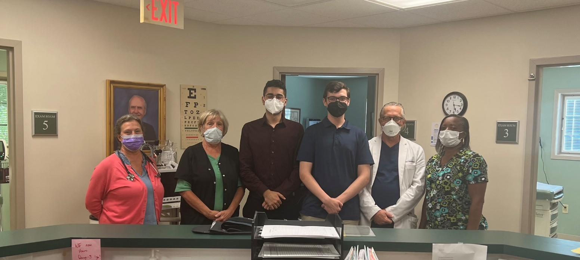
NORTHERN NECK - MIDDLESEX FREE HEALTH CLINIC
In the Medical Clinic
“My experiences at the clinic taught me about the many aspects of patient interaction. Whether it was taking vital signs, drawing blood or assisting in bringing patients back to the exam rooms, I felt a connection to this underserved population…. I am glad that NNMFHC continues to treat medicine as a basic human need, rather than a luxury.”
– 2022 intern Omar Jawhar
“Working with the NNMFHC has been an experience like none other. In only three weeks I have had the opportunity to help in both the medical and dental clinics, as well as in the pharmacy. In this short time I have seen the profound impact the NNMFHC has on its community.”
- 2022 intern Liam McMillan
At the nurses’ station are (l-r) Tamara Hall, Nurse Practitioner; Linda Davis, RN; summer interns in 2022, Omar Jawhar and Liam McMillan; Dr. Paul Sutherland, and medical assistant Michele Fulcher.

Slide 15
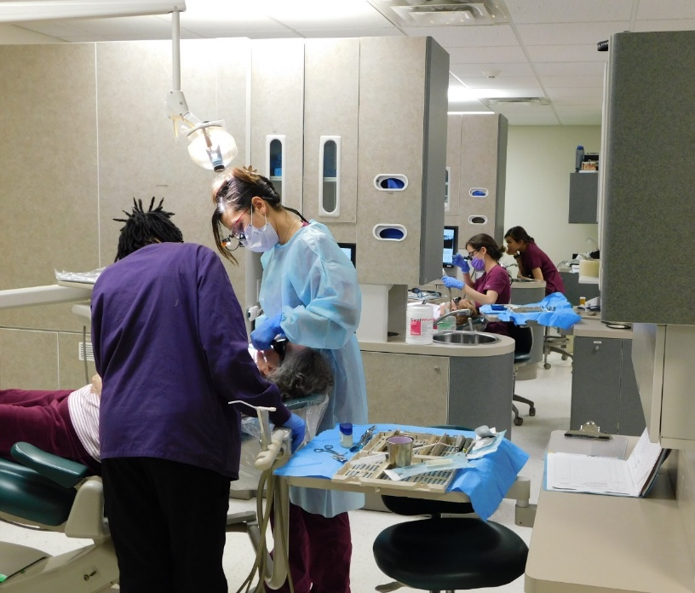
NORTHERN NECK - MIDDLESEX FREE HEALTH CLINIC
In the Dental Clinic
The Dental Clinic serves patients of all ages – children on Medicaid, adults, and seniors on Medicare.
Our staff dentist is adjunct faculty at the VCU School of Dentistry and supervises four final-year dental students and one hygiene student each week.
(During Covid-19, three part-time dentists filled in for work normally done by the dental students)
During 2022, the Dental Clinic:
Served 1,316 unduplicated patients
Hosted 3,332 dental visits
Performed 7,612 procedures
The value of dental care provided during 2022 totaled $1,065,995

Slide 16
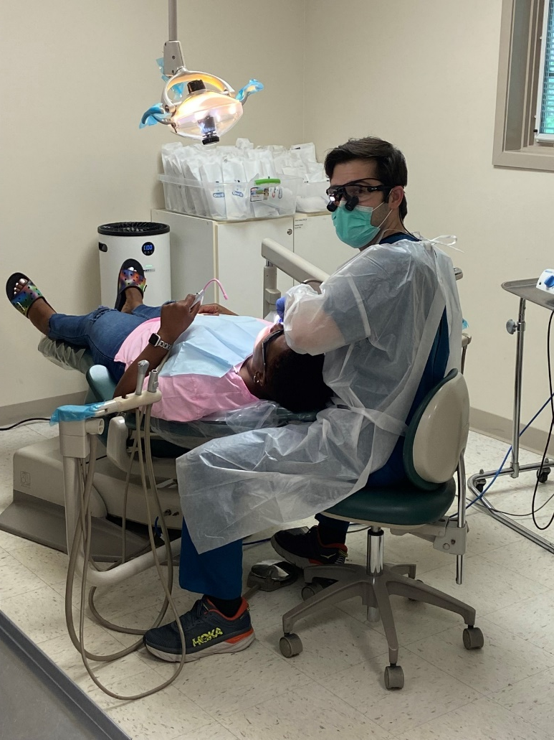
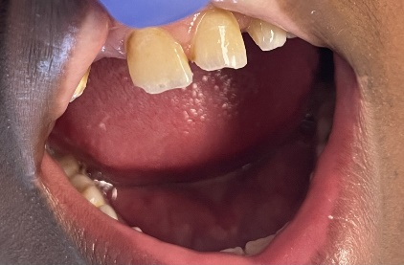
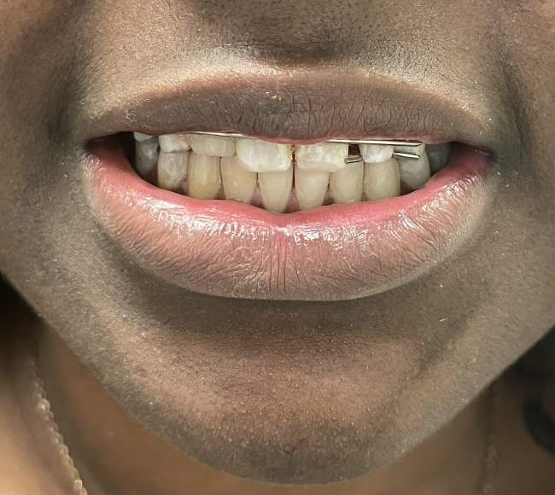
NORTHERN NECK - MIDDLESEX FREE HEALTH CLINIC
In the Dental Clinic
Final-year students at the VCU School of Dentistry gain hands-on experience during their rotations on Wednesdays, Thursdays, and Fridays. Rather than drive back to Richmond the five students each week are able to stay nearby in the Clinic’s first home on DMV Drive, refurbished as a dormitory and a meeting space.
“I feel like I can smile all over again.”
- Patient Logan Lee

Slide 17
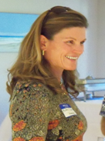
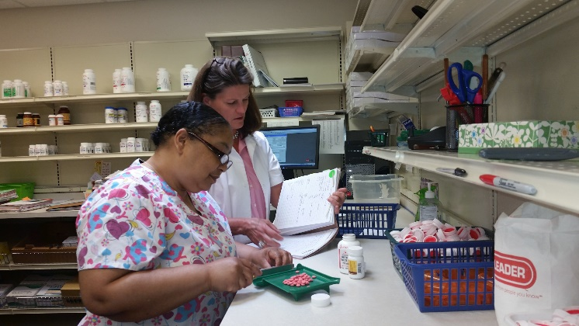
NORTHERN NECK - MIDDLESEX FREE HEALTH CLINIC
In the Pharmacy
Covid vaccine clinics are
Operated through the pharmacy
Pharmacy coordinator Angie Rich and Pharmacist Britney Dedmond
Through 2022, the Pharmacy has supplied
more than 645,657 prescriptions to help our neighbors in need
manage their chronic conditions, stay in the work force,
and enjoy a healthier lifestyle.
During 2022, the Pharmacy filled 13,657 prescriptions valued at $3,383,938.

Slide 18
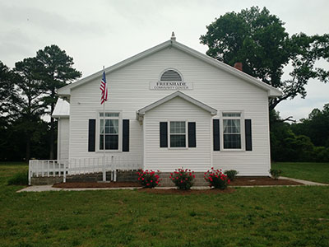
NORTHERN NECK - MIDDLESEX FREE HEALTH CLINIC
The Outreach Office in Middlesex County
Open every Thursday afternoon
at Freeshade Community Center
in Syringa
Established in February of 2009, the Outreach Office led to a 75% increase in services to Middlesex County patients within two years.
The office allows patients to be screened for eligibility, receive prescription assistance, and pick up their medicines without having to make trips across the Rappahannock River to the main Clinic facility.

Slide 19
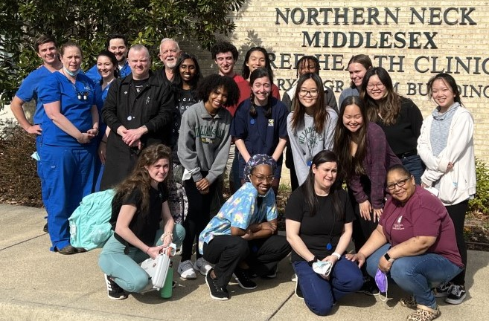
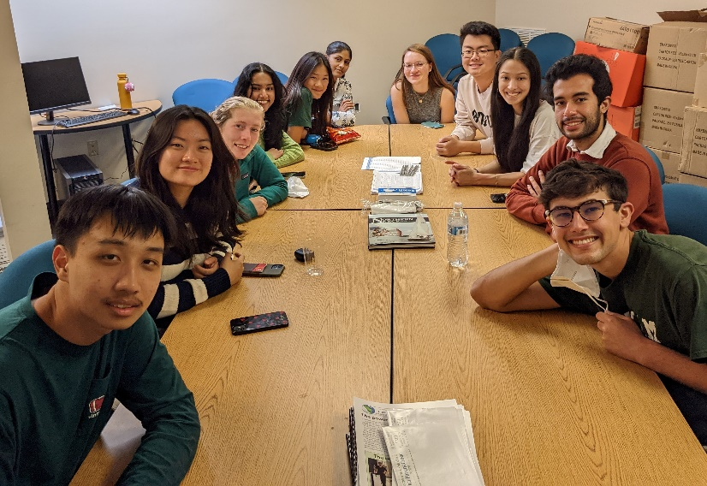
NORTHERN NECK - MIDDLESEX FREE HEALTH CLINIC
For the eighth year in a row, students from the College of William & Mary spent their spring break in 2020 doing community service work at the Clinic. Their spring break week coincided with the emerging coronavirus, however, and the 11 students were called back to the school a day and a half early, while the Clinic began putting new safety protocols into effect. After a break in 2021, W&M students returned in 2022 for a ninth year of community service.
Spring of 2022
This time, their trip coincided with VCU School of Dentistry student rotations. The W&M and VCU students are shown with some of the Clinic staff.
“These students move mountains for us every year,” said Jean Nelson, Clinic CEO. “They help keep our files archived and current, assist at the medical and dental reception, catch up on printing needs and so much more. Plus they’re a delight to have around. Our hope is that the experience of working with patients, volunteers and staff in a rural health care setting has a positive and meaningful impact on their lives.”
Fall of 2022
The Clinic got a double dose of help during 2022. After the week-long “break-out” visit this spring (above), students for the first time also used their fall break for community service work at the Clinic. The 11 students (at right) again moved mountains, helping to organize files, supplies, and charts, and assist with patient reception.

Slide 20
Expenditures (2021-2021 fiscal year) Operating budget comes solely from donations
NORTHERN NECK - MIDDLESEX FREE HEALTH CLINIC

Slide 21
Sources of funds (2021-22 fiscal year) Clinic funded solely on donations!
NORTHERN NECK - MIDDLESEX FREE HEALTH CLINIC

Slide 22
Volunteers have contributed nearly 415,000 hours since the Clinic’s founding, and the Clinic has provided over $137 million worth of health care services.
NORTHERN NECK - MIDDLESEX FREE HEALTH CLINIC
Fiscal-year budget
July 1, 2022 to June 30, 2023:
$1,877,851

